Slide 1


Simple steps to get student engagement when teaching climate change online
Ana Mesquita Emlinger
PhD Candidate – Online Instructor UMASS Amherst

Slide 2
1. Personal introduction
2. Significance of the subject
3. Seven easy steps
Ana Mesquita Emlinger
amesquit@larp.umass.edu

Slide 3
1. Personal Introduction
Architecture and Urbanism
Teaching experience
    - Traditional (11 years in Brazil)
    - Online (2 years in USA) – 2015 will be the 3rd!
PhD Candidate at UMASS Amherst
- Dissertation: Status of efforts and local preparedness for climate change adaptation in small coastal communities of New England
(Advisor: Elisabeth Hamin)
Ana Mesquita Emlinger
amesquit@larp.umass.edu

Slide 4
2. Significance of the subject
Research has demonstrated that engaging students in the learning process:
Increases their attention and focus
Motivates them to practice higher-level critical thinking skills, and
Promotes meaningful learning experiences.
(Center for Teaching and Learning, University of
Washington)
Ana Mesquita Emlinger
amesquit@larp.umass.edu

Slide 5
3. Seven Easy Steps
1. Promote Active Learning
Active learning requires students to participate in class, as opposed to sitting and listening quietly.
Use of student-centered approach: increase opportunities for student engagement
Example: Interview with planner
Ana Mesquita Emlinger
amesquit@larp.umass.edu

Slide 6
3. Seven Easy Steps
2. Group work
Use of self-enrollment as preferable option
Group work = Student Inclusive Strategy
Example: Discuss/compare the interviews (intermediary tasks)
Ana Mesquita Emlinger
amesquit@larp.umass.edu

Slide 7
3. Seven Easy Steps
3. Consistency in weekly structure
1. Video of the week
2. Readings of the week
3. Discussions
4. Special Task of the week
5. “Under Observation”
6. Supplemental Material
The course structure will be the same as listed above. The content will vary each week.
Ana Mesquita Emlinger
amesquit@larp.umass.edu

Slide 8
3. Seven Easy Steps
4. Plurality of resources
Different learners require different resources
Example: Video, articles, interesting questions for discussions, group work, creative presentations…
Ana Mesquita Emlinger
amesquit@larp.umass.edu

Slide 9
3. Seven Easy Steps
5. Post the most recent news
It shows YOU are updated and focused on the subject
Link the issue addressed in the news with previous discussions, make challenging questions, provocative statements…
Ana Mesquita Emlinger
amesquit@larp.umass.edu

Slide 10
3. Seven Easy Steps
6. Distribution of deadlines
Ana Mesquita Emlinger
amesquit@larp.umass.edu

Slide 11
3. Six Easy Steps
7. Take them out of their “Comfort zone”
“The world is full of magic things waiting patiently for our senses to sharpen” John Keats
Propose an exercise that will challenge them: I use weekly analysis of the same pieces of art
Private reflection for 5 weeks + open discussion in the last week of the course
Example: Under Observation exercise
Ana Mesquita Emlinger
amesquit@larp.umass.edu

Slide 12
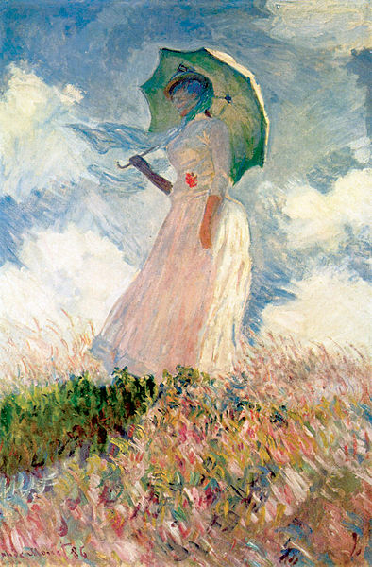
Ana Mesquita Emlinger
amesquit@larp.umass.edu

Slide 13
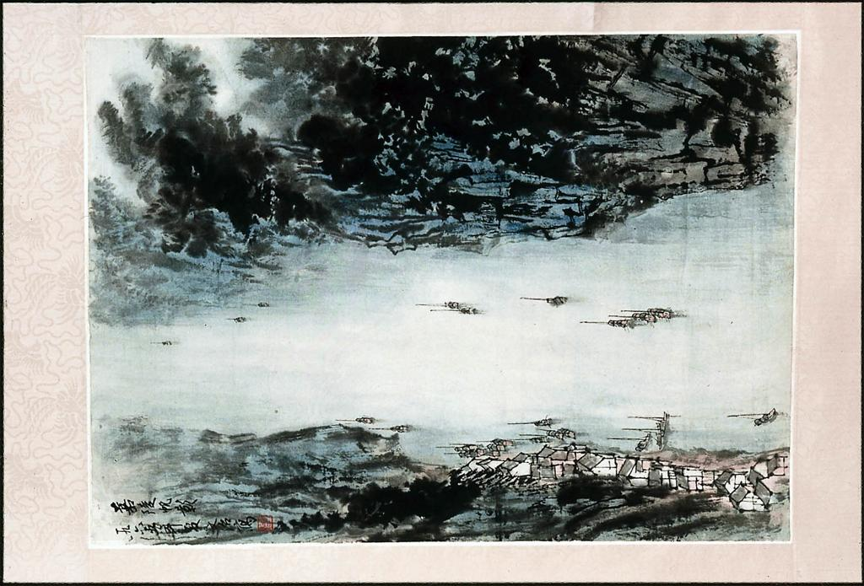
Ana Mesquita Emlinger
amesquit@larp.umass.edu

Slide 14
Ana Mesquita Emlinger
amesquit@larp.umass.edu

Slide 15
Summary of the 7 Steps
1 | Active learning
2 | Group work
3 | Consistency
4 | Variety of resources
5 | Recent news
6 | Deadlines
7 | Out of comfort zone
Ana Mesquita Emlinger
amesquit@larp.umass.edu

Slide 16
Summary of the 7 Steps
1 | Active learning
2 | Group work
3 | Consistency
4 | Variety of resources
5 | Recent news
6 | Deadlines
7 | Out of comfort zone
Ana Mesquita Emlinger
amesquit@larp.umass.edu

Slide 17
Summary of the 7 Steps
1 | Active learning
2 | Group work
3 | Consistency
4 | Variety of resources
5 | Recent news
6 | Deadlines
7 | Out of comfort zone
Ana Mesquita Emlinger
amesquit@larp.umass.edu

Slide 18
Summary of the 7 Steps
1 | Active learning
2 | Group work
3 | Consistency
4 | Variety of resources
5 | Recent news
6 | Deadlines
7 | Out of comfort zone
Ana Mesquita Emlinger
amesquit@larp.umass.edu

Slide 19
Summary of the 7 Steps
1 | Active learning
2 | Group work
3 | Consistency
4 | Variety of resources
5 | Recent news
6 | Deadlines
7 | Out of comfort zone
Ana Mesquita Emlinger
amesquit@larp.umass.edu

Slide 20
Summary of the 7 Steps
1 | Active learning
2 | Group work
3 | Consistency
4 | Variety of resources
5 | Recent news
6 | Deadlines
7 | Out of comfort zone
Ana Mesquita Emlinger
amesquit@larp.umass.edu

Slide 21
Summary of the 7 Steps
1 | Active learning
2 | Group work
3 | Consistency
4 | Variety of resources
5 | Recent news
6 | Deadlines
7 | Out of comfort zone
Ana Mesquita Emlinger
amesquit@larp.umass.edu

Slide 22
Summary of the 7 Steps
1 | Active learning
2 | Group work
3 | Consistency
4 | Variety of resources
5 | Recent news
6 | Deadlines
7 | Out of comfort zone
Ana Mesquita Emlinger
amesquit@larp.umass.edu

Slide 23
Thank you!
Ana Mesquita Emlinger
amesquit@larp.umass.edu

